Slide 1
Hello, everyone!

Slide 2
Education
Sofia university “St. Kliment Ohridski”
Bachelor’s degree
Bulgarian philology
Master’s degree
Linguistics

Slide 3
Master’s thesis
Typology of the Bulgarian bridging anaphora
Adaptation of M. Ogrodniczuk’s and M. Zawislawska’s categorization for Polish language

Slide 4
Work
IICT-BAS – Department of linguistic modeling and knowledge processing
CLaDA-BG (CLARIN and DARIAH in Bulgaria)

Slide 5
Work (1)
Annotation of coreference chains
Using the web-based annotation tool WebAnno
Following the English OntoNotes guidelines for coreference annotation
Newspaper articles and fiction literature

Slide 6
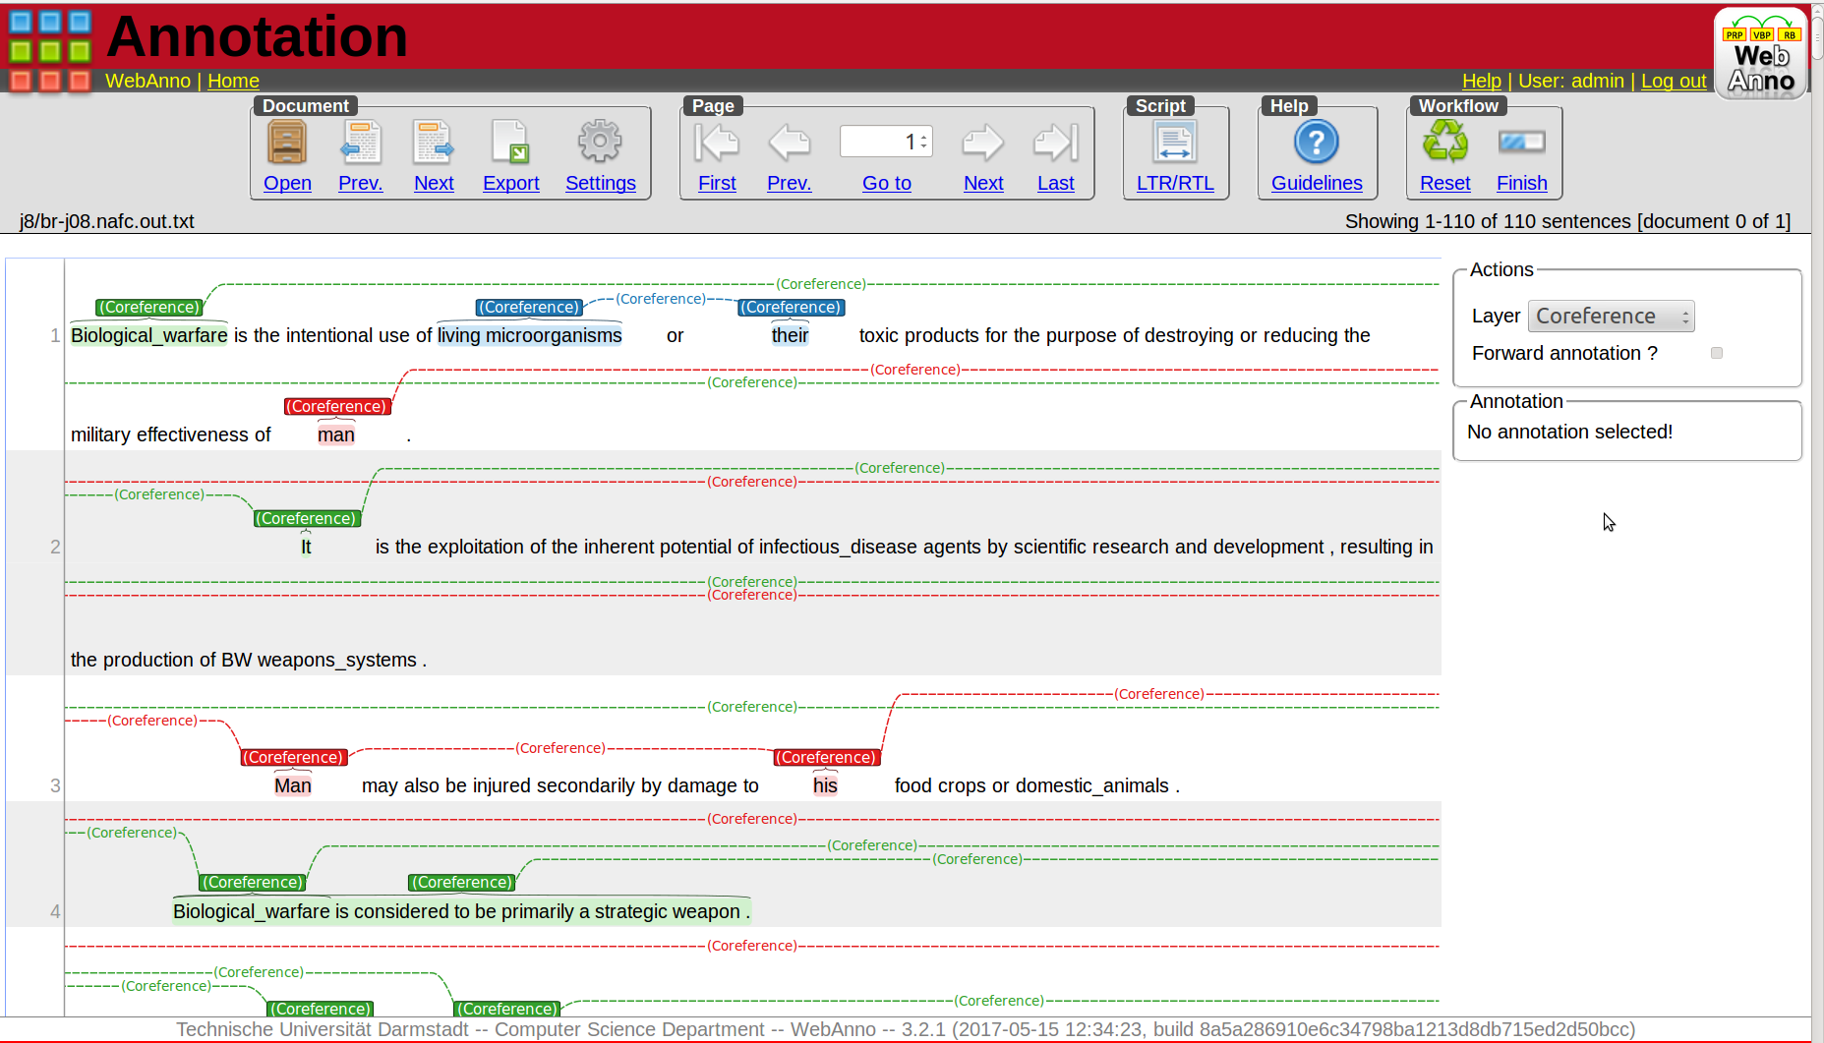
WebAnno annotation

Slide 7
Work (2)
The Bulgarian WordNet
Using the XML-based CLaRK software system for corpora development
Frequency list of words over a large corpus, identification of the missing words, definition, example and mapping to the English WordNet

Slide 8
Work (2)
The Bulgarian WordNet
Using the XML-based CLaRK software system for corpora development
Frequency list of words over a large corpus, identification of the missing words, definition, example and mapping to the English WordNet

Slide 9
Mapping relations
Default relation – equality of the senses
Subsumption relation – English entity is more general than the Bulgarian (verbs, which mark the start of the action)
Specificity relation – Bulgarian entity is more general (mafia)

Slide 10
Mapping relations
Default relation – equality of the senses
Subsumption relation – English entity is more general than the Bulgarian (verbs, which mark the start of the action)
Specificity relation – Bulgarian entity is more general (mafia)

Slide 11
Mapping relations (1)
Idioms – completely match in meaning
Cross lingual conversion – cross POS mapping (Adj to Noun)
fox – лисица
fox (fur) – лисича (кожа)

Slide 12
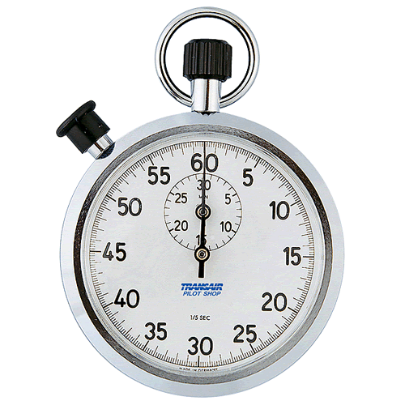
Time’s Up!
About me:
  Name: Zara Kancheva
  Institution: IICT-BAS

